Slide 1
Week 13: Processes, Context Switching, Threads
BHOS C Programming, Ahad Suleymanli

Slide 2
Outline
OUTLINE
Process Concept
Operations on Processes
Context
Context Switching
Parallel execution
Threads vs Processes
Thread Libraries
Thread safety
2

Slide 3
Process Management
A process is a program in execution.
Unit of work in the system
(Process is an active entity a program is passive).
Process executes instructions sequentially, one at a time, until completion
Process needs resources to accomplish its task
CPU, memory, I/O, files
Typically system has many processes running concurrently
Some of them may be OS processes
Upon termination, resources are released
Vi
Firefox
Gcc
3

Slide 4
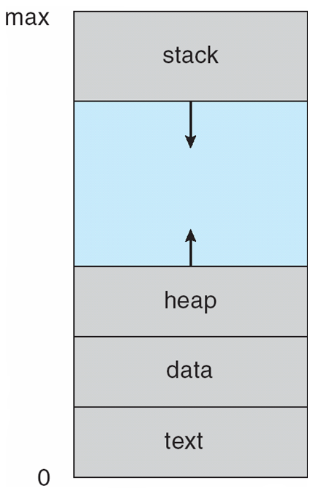
Process: program in execution
CPU
(Physical)
Main Memory
(RAM)
registers
PSW
PC
IR
CPU state of the process
(CPU context)
process address space
(currently used portion of the address space must be in memory)
4

Slide 5
Multiple Processes
one program counter
Process
A
processes
Three program counters
Process
B
C
Process
A
Process
B
Process
C
B
Process
C
A
time
Conceptual model
of three different processes
what is
happening physically
one process executing at a time
5

Slide 6
Process in Memory
Stack segment (holds the called function parameters,
local variables, return values)
Storage for dynamically created
variables
Data segment (includes global variables, arrays, etc., you use)
Text segment (code segment)
(instructions are here)
A process needs this memory content to run
(called address space; memory image)
6

Slide 7
Process Address Space
A process can only access its address space
Each process has its own address space
Kernel can access everything
7

Slide 8
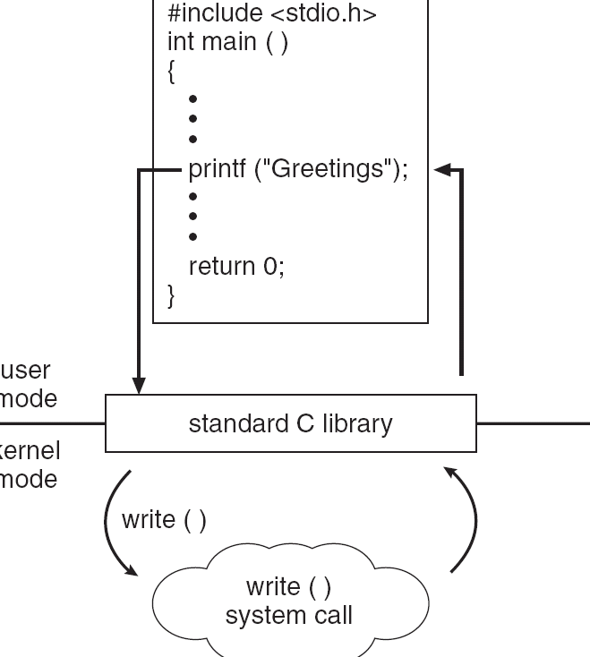
Example of Kernel At Work (Syscal)
C program invoking printf() library call, which calls write() system call
8

Slide 9
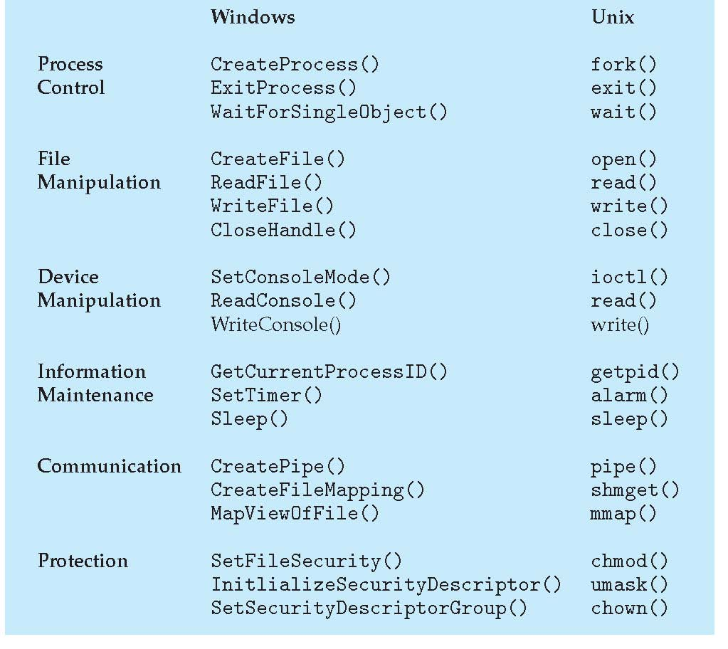
Examples of Windows and Unix System Calls
9

Slide 10
Process State
As a process executes, it changes state
new: The process is being created
running: Instructions are being executed
waiting: The process is waiting for some event to occur
ready: The process is waiting to be assigned to a processor
terminated: The process has finished execution
In a single-CPU system, only one process may be in running state; many processes may be in ready and waiting states.

Slide 11
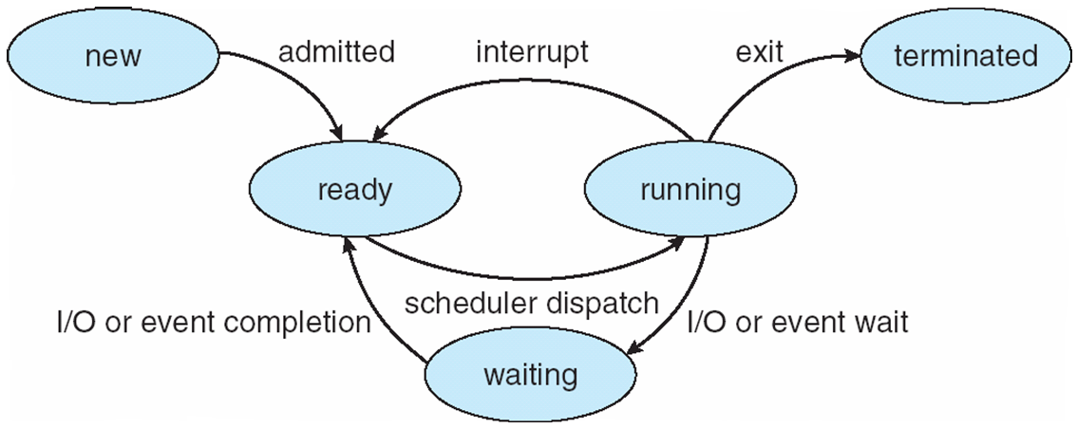
Diagram of Process State

Slide 12
Process Control Block
Information associated with each process
Process state (ready, running, waiting, etc)
Program counter (PC)
CPU registers
CPU scheduling information
Priority of the process, etc.
Memory-management information
text/data/stack section pointers, sizes, etc.
pointer to page table, etc.
Accounting information
CPU usage, clock time so far, …
I/O status information
List of I/O devices allocated to the process, a list of open files, etc.

Slide 13
Process Representation in Linux
In Linux kernel source tree, the file include/linux/sched.h contains
the definition of the structure task_struct, which is the PCB for a process.
struct task_struct {
long state; /* state of the process */
….
pid_t; pid /* identifier of the process */
…
unisgned int time_slice; /* scheduling info */
…
struct files_struct *files; /* info about open files */
….
struct mm_struct *mm; /* info about the address space of this process */
…
}

Slide 14
PCBs
Process 1
Process 2
Process 3
Process N
stack
stack
stack
stack
process
address space
data
data
data
data
text
text
text
text
PCB
1
PCB
2
PCB
3
PCB N
Kernel Memory
Kernel mains a PCB for each process. They can be linked together in various queues.

Slide 15
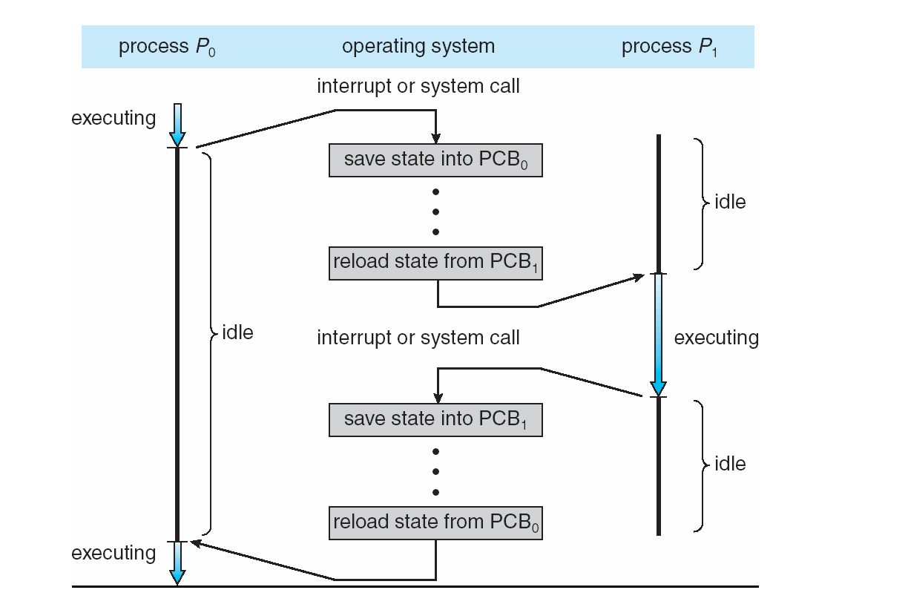
CPU Switch from Process to Process

Slide 16
Process Behavior
Processes can be described as either:
I/O-bound process – spends more time doing I/O than computations, many short CPU bursts
CPU-bound process – spends more time doing computations; few very long CPU bursts
CPU burst: the execution of the program in CPU between two I/O requests (i.e. time period during which the process wants to continuously run in the CPU without making I/O)
We may have a short or long CPU burst.
I/O bound
CPU bound
waiting
waiting

Slide 17
Context Switch
When CPU switches to another process, the system must save the state of the old process and load the saved state for the new process via a context switch
Context of a process represented in the PCB
Context-switch time is overhead; the system does no useful work while switching
Time dependent on hardware support

Slide 18
Processes vs Threads
Processes are spawned with the help of the kernel using fork()
Threads are spawned with the help of the kernel using clone()

Slide 19
More differences
If your main process creates a 2nd process, now you have two different address spaces (stack, heap, data, text) in memory
If your main process creates a 2nd thread now you share your address space except the stack!

Slide 20
Threads

Slide 21
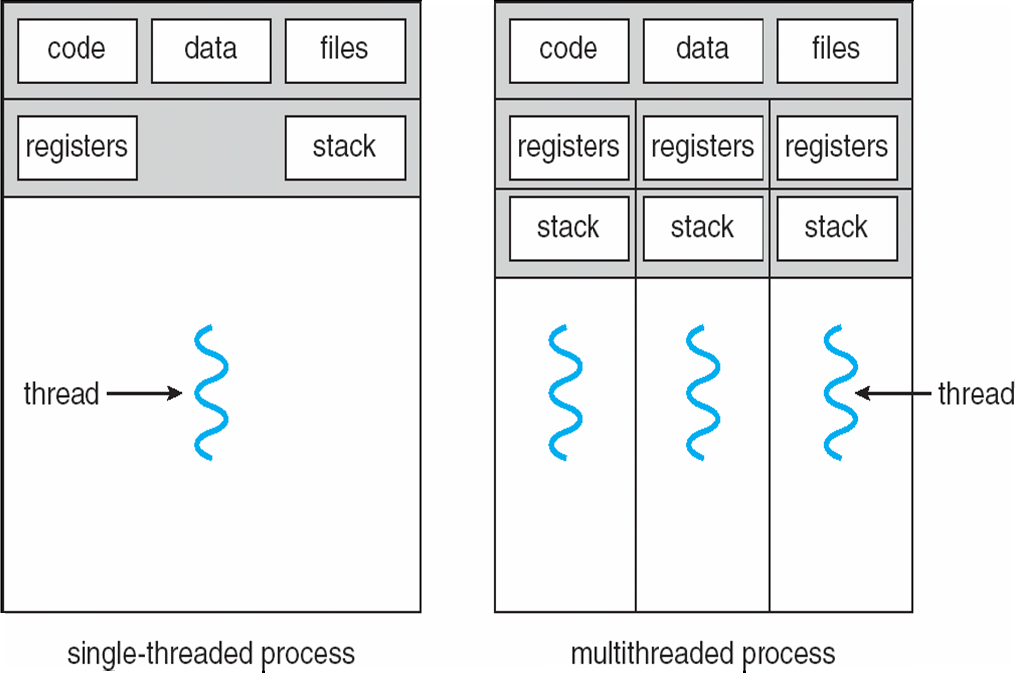
Single and Multithreaded Processes
21

Slide 22
Multithreading Concept
function1(…)
{
….
{
function2(…)
{
….
{
main()
{ ….
thread_create (function1 ,…);
….
thread_create (function2, …);
….
thread_create (function1, …);
….
}
thread1
thread2
thread3
thread4
22

Slide 23
Multicore programming and multithreading challenges
Multicore systems putting pressure on programmers.
Threading can utilize Multicore systems better, but it has come challenges
Threading Challenges include
Dividing activities
Come up with concurrent tasks
Balance
Tasks should be similar importance and load
Data splitting
Data may need to be split as well
Data dependency
Data dependencies should be considered; need synchronization of activities
Testing and debugging
Debugging is more difficult
23

Slide 24
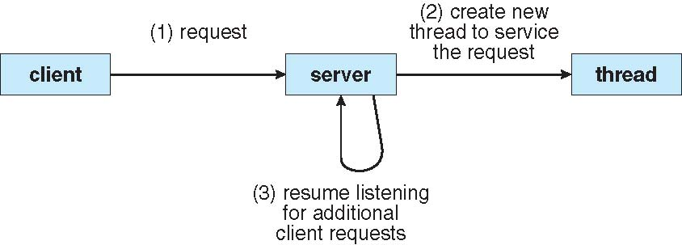
Multithreaded Server Architecture
24

Slide 25
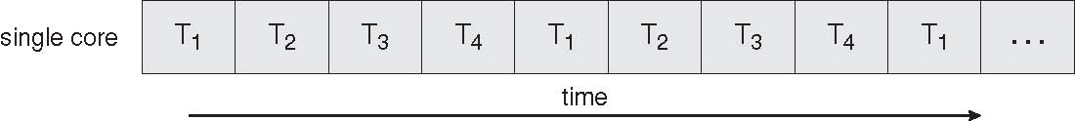
Concurrent Execution on a Single-core System
25

Slide 26
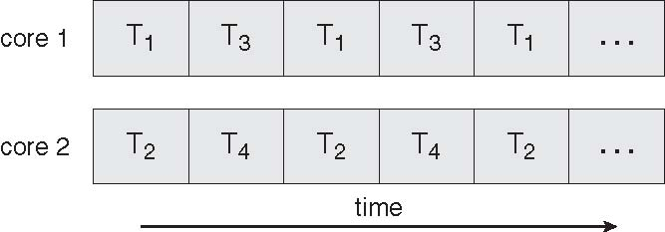
Parallel Execution on a Multicore System
26

Slide 27
Threading Support
27

Slide 28
Threading Support
Multithreading can be supported by:
User level libraries (without Kernel being aware of it)
Library creates and manages threads (user level implementation)
Kernel itself
Kernel creates and manages threads (kernel space implementation)
No matter which is implemented, threads can be created, used, and terminated via a set of functions that are part of a Thread API (a thread library)
Three primary thread libraries: POSIX threads, Java threads, Win32 threads
28

Slide 29
Thread Libraries
Thread library provides programmer with API for creating and managing threads
Programmer just have to know the thread library interface (API).
Threads may be implemented in user space or kernel space.
library may be entirely in user space or may get kernel support for threading
29

Slide 30
Pthreads Library
May be provided either as user-level or kernel-level
A POSIX standard (IEEE 1003.1c) API for thread creation and synchronization
API specifies behavior of the thread library, implementation is up to development of the library
Common in UNIX operating systems (Solaris, Linux, Mac OS X)
30

Slide 31
Pthreads Example
We will show a program that creates a new thread.
Hence a process will have two threads :
1 - the initial/main thread that is created to execute the main() function (that thread is always created even there is no support for multithreading);
2 - the new thread.
(both threads have equal power)
The program will just create a new thread to do a simple computation: will sum all integers upto a given parameter value
sum = 1+2+…+parameter_value
The main thread will wait until sum is computed into a global variable.
Then the main thread will print the result.
31

Slide 32
Pthreads Example
#include <pthread.h>
#include <stdio.h>
int sum; /* shared sum by threads – global variable */
void *runner (void *param); /* thread start function */
32

Slide 33
Pthreads Example
int main(int argc, char *argv[]){
pthread_t tid; /* id of the created thread */
pthread_attr_t attr; /* set of thread attributes */
if (argc != 2) {
fprintf (stderr, “usage: a.out <value>\n”);
return -1;
}
if (atoi(argv[1]) < 0) {
fprintf (stderr, “%d must be >= 0\n”, atoi(argv[1]);
return -1;
}
pthread_attr_init (&attr);
pthread_create (&tid, &attr, runner, argv[1]);
pthread_join (tid, NULL);
printf (“sum = %d\n”, sum);
}
33

Slide 34
Pthreads Example
int main(int argc, char *argv[]){
pthread_t tid; /* id of the created thread */
pthread_attr_t attr; /* set of thread attributes */
if (argc != 2) {
fprintf (stderr, “usage: a.out <value>\n”);
return -1;
}
if (atoi(argv[1]) < 0) {
fprintf (stderr, “%d must be >= 0\n”, atoi(argv[1]);
return -1;
}
pthread_attr_init (&attr);
pthread_create (&tid, &attr, runner, argv[1]);
pthread_create (&tid, &attr, runner, argv[1]);
pthread_join (tid, NULL);
pthread_join (tid2, NULL);
printf (“sum = %d\n”, sum);
}
34

Slide 35
Pthreads Example
void *runner (void *param)
{
int i;
int *upper;
upper = (int*)(param);
sum = 0;
for (i = 1; i <= upper; ++i)
sum += i;
pthread_exit(0);
}
35

Slide 36
Pthreads Example
int main(…)
{
bool stop = false;
…
….
pthread_create(&tid,…,runner,&stop);
pthread_join(tid);
. printf (…, sum, …);
}
runner (…) {
while(1)
{
if (*stopPtr == true){
pthread_exit();
}
}
….
sum = …
pthread_exit();
{
thread1
thread2
wait
36

Slide 37
Compiling and running the program
You can put the above code into a .c file, say mysum.c
In order to use the Pthreads functions, we need to include pthread.h header file in our program (as shown in previous slides)
We also need to link with the pthread library (the Pthreads API functions are not implemented in the standard C library). The way to do that is using the –l option of the C compiler. After –l you can provide a library name like pthread.
Hence we can compile+link our program as follows:
gcc -Wall -o mysum -lpthread mysum.c
Then we run it as (for example):
./mysum 6
It will print out 21
37

Slide 38
Other Threading Issues
38

Slide 39
Interpreted Languages
Java threads are managed by the JVM
C# threads are managed by CLR (common language runtime by MS)
Python threads are managed by CPython interpreter
(python threads are terrible, use multiprocessing if possible)
Typically implemented using the threads model provided by underlying OS

Slide 40
Threading Issues
Thread cancellation of target thread
Asynchronous or deferred
Signal handling
Thread pools
Thread-specific data
40

Slide 41
Thread Cancellation
Terminating a thread before it has finished
Need at various cases
Two general approaches:
Asynchronous cancellation terminates the target thread immediately
Deferred cancellation allows the target thread to periodically check if it should be cancelled
Cancelled thread has sent the cancellation request
41

Slide 42
Signal Handling
If a signal is send to Multithread Process, who will receive and handle that?
In a single thread process, it is obvious.
42

Slide 43
Examples of Linux Signals
Ctrl+C: SIGINT (terminate)
Ctrl+D (sends EOF to stdin)
Ctrl+Z: SIGSTP (stosuspends the process)
ps -aux | less
kill -9 {process id}

Slide 44
Thread Pools
Create a number of threads in a pool where they await for work
Advantages:
Faster
Limit the count of threads:
Allows the number of threads in the application to be bound to the size of the pool
44

Slide 45
From Single-threaded to Multithreaded
Many programs are written as a single threaded process.
If we try to convert a single-threaded process to multi-threaded process, we have to be careful about the following:
the global variables
the library functions we use
45

Slide 46
From Singlethread to Multithreaded
int status; // a global variable
func1(…) {
….
status = …
do_something_based_on(status);
}
func2(…) {
…
status = …
do_something_based_on(status);
}
main() {
….
func1 (…);
func2 (…);
}
This is a single threaded program
46

Slide 47
From Singlethread to Multithreaded
int status;
func1(…) {
….
status = …
do_something_based_on(status);
}
func2(…) {
…
status = …
do_something_based_on(status);
}
main() {
….
thread_create(…, func1, …);
thread_create(…, func2, …);
}
We can have problem here.
Just after func1 of thread 1 updated status, a thread switch may occur and 2nd thread can run and update status.
Then thread 1 will run again, but will work with a different status value.
Wrong result!
47

Slide 48
From Single-threaded to Multithreaded
Scope of variables:
Normally we have: global, local
With threads we want: global, local, and thread-specific
thread-specific: global inside the thread (thread-wide global), but not global for the whole process. Other threads can not access it. But all functions of the thread can.
But we don’t have language support to define such variables.
C can not do that.
Therefore thread API has special functions that can be used to create such variables – data.
This is called thread specific data.
48

Slide 49
Note on Global Variables
In this course we will not use any kind of global variables (except constants)
Global = evil
Instead we will learn to use references to variables created on the heap

Slide 50
Thread Specific Data
Allows each thread to have its own copy of data
Each thread refers to the data with the same name.
create_global (“bufptr”); // create pointer to such a variable
set_global (“bufptr”, &buf); // set the pointer
bufptr = read_global (“bufptr”); // get the pointer to access
50

Slide 51
From Singlethread to Multithreaded
Many library procedures may not be reentrant.
They are not designed to have a second call to itself from the same process before it is completed (not re-entrant).
(We are talking about non-recursive procedures.)
They may be using global variables. Hence may not be thread-safe.
We have to be sure that we use thread-safe (reentrant) library routines in multi-threaded programs we are developing.
51

Slide 52
Context switching re-visited
Process 1
Process 2
Process 3
Process N
stack
stack
stack
stack
process
address space
data
data
data
data
text
text
text
text
PCB
1
PCB
2
PCB
3
PCB N
Kernel Memory

Slide 53
Context switching re-visited cont.d
CPU
(Physical)
Main Memory
(RAM)
registers
PSW
PC
IR
CPU state of the process
(CPU context)
process address space
(currently used portion of the address space must be in memory)

Slide 54
Context switching re-visited cont.d
The register set, stacks, and private storage area are known as the context of the threads

Slide 55
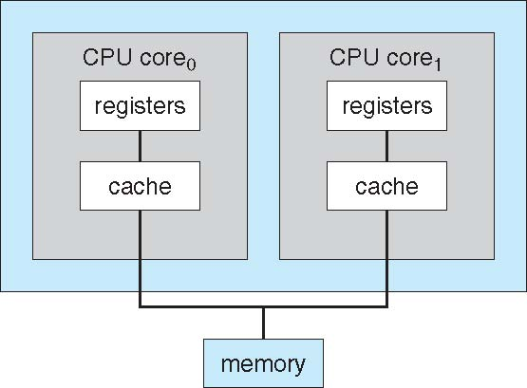
A Dual Core Design
55

Slide 56
Synchronization
Dealing with:
Race conditions
Deadlocks
Thread starvation

Slide 57
Critical Section Problem
Objectives
To introduce the critical-section problem
Critical section solutions can be used to ensure the consistency of shared data
To present both software and hardware solutions of the critical-section problem

Slide 58
Background
Concurrent access to shared data may result in data inconsistency
Maintaining data consistency requires mechanisms to ensure the orderly execution of cooperating processes
Shared Data
Can be a shared memory variable, a global variable
in a multi-thread program or a file; or a kernel variable
Concurrent Threads or Processes
3

Slide 59
Producer Consumer Proble
Below is a solution to the consumer-producer problem that fills all the slots of the shared buffer.
Use an integer count to keep track of the number of full slots.
Initially, count is set to 0. It is incremented by the producer after it puts a new item and is decremented by the consumer after it retrieves an item from the buffer
also a shared variable
Producer
count
Consumer
Shared Buffer
at most BUFFER_SIZE items

Slide 60
Producer and Consumer Code
Producer
ConSUMER
while (true) {
/*produce an item*/
nextProduced = ….
while (count == BUFFER_SIZE)
; // do nothing
buffer [in] = nextProduced;
in = (in + 1) % BUFFER_SIZE;
count++;
}
while (true) {
while (count == 0)
; // do nothing
nextConsumed = buffer[out];
out = (out + 1) % BUFFER_SIZE;
count--;
/*consume item nextConsumed*/
}

Slide 61
a possible Problem: race condition
Assume we had 5 items in the buffer
Then:
Assume producer has just produced a new item and put it into buffer and is about to increment the count.
Assume the consumer has just retrieved an item from buffer and is about the decrement the count.
Namely: Assume producer and consumer is now about to execute count++ and count– statements.

Slide 62
Producer
Consumer
or
Producer
Consumer

Slide 63
Race Condition
count++ could be implemented as register1 = count register1 = register1 + 1 count = register1
count-- could be implemented as register2 = count register2 = register2 - 1 count = register2

Slide 64
Race Condition
register1
Count
PRODUCER (count++)
5
6
5
6
4
register1 = count
register1 = register1 + 1
count = register1
register1 = count
register1 = register1 + 1
count = register1
register2
5
4
CONSUMER (count--)
register2 = count
register2 = register2 – 1
count = register2
register2 = count
register2 = register2 – 1
count = register2
CPU
6
Main Memory

Slide 65
Interleaved Execution sequence
Consider this execution interleaving with “count = 5” initially:
S0: producer execute register1 = count {register1 = 5} S1: producer execute register1 = register1 + 1 {register1 = 6} S2: consumer execute register2 = count {register2 = 5} S3: consumer execute register2 = register2 - 1 {register2 = 4} S4: producer execute count = register1 {count = 6 } S5: consumer execute count = register2 {count = 4}
10

Slide 66
Programs and critical sections
The part of the program (process) that is accessing and changing shared data is called its critical section
Process 1 Code
Process 2 Code
Process 3 Code
Change X
Change X
Change Y
Change Y
Change Y
Change X
Assuming X and Y are shared data.

Slide 67
Program lifetime and its structure
Considering a process:
It may be executing critical section code from time to time
It may be executing non critical section code (remainder section) other times.
We should not allow more than one process to be in their critical regions where they are manipulating the same shared data.

Slide 68
Structuring Programs
The general way to do that is:
do {
entry section
critical section
exit section
remainder
} while (TRUE)
do {
critical section
remainder section
} while (TRUE)
The general structure of a program
Entry section will allow only one process to enter and execute critical section code.

Slide 69
Solution to Critical-Section Problem
Mutual Exclusion - If process P_{i} is executing in its critical section, then no other processes can be executing in their critical sections
Progress - If no process is executing in its critical section and there exist some processes that wish to enter their critical section, then the selection of the processes that will enter the critical section next cannot be postponed indefinitely // no deadlock
Bounded Waiting - A bound must exist on the number of times that other processes are allowed to enter their critical sections after a process has made a request to enter its critical section and before that request is granted // no starvation of a process
Assume that each process executes at a nonzero speed
No assumption concerning relative speed of the N processes

Slide 70
Applications and Kernel
Multiprocess applications sharing a file or shared memory segment may face critical section problems.
Multithreaded applications sharing global variables may also face critical section problems.
Similarly, kernel itself may face critical section problem. It is also a program. It may have critical sections.

Slide 71
Peterson’s Solution
Two process solution
Assume that the LOAD and STORE instructions are atomic; that is, cannot be interrupted.
The two processes share two variables:
int turn;
Boolean flag[2]
The variable turn indicates whose turn it is to enter the critical section.
The flag array is used to indicate if a process is ready to enter the critical section. flag[i] = true implies that process P_{i} is ready!

Slide 72
Algorithm for Process P_{i}
do {
flag[i] = TRUE;
turn = j;
while (flag[j] && turn == j);
critical section
flag[i] = FALSE;
remainder section
} while (1)
entry section
exit section

Slide 73
Two processes executing concurrently
PROCESS i (0)
PROCESS j (1)
do {
flag[i] = TRUE;
turn = j;
while (flag[j] && turn == j);
critical section…..
flag[i] = FALSE;
remainder section…..
} while (1)
do {
flag[j] = TRUE;
turn = i;
while (flag[i] && turn == i);
critical section…..
flag[j] = FALSE;
remainder section…..
} while (1)
flag[]
turn
Shared Variables

Slide 74
Synchronization Hardware
We can use some hardware support (if available) for protecting critical section code
1) Disable interrupts? maybe
Sometimes only (kernel)
Not on multiprocessors
2) Special machines instructions and lock variables
TestandSet
Swap

Slide 75
Synchronization Hardware
Use of lock variables is a general and very common approach.
What happens if you a lock variable without special instructions?
Can be source of race conditions
Example:
int lock = 0; // global variable (shared among threads)
Thread 1
Thread 2
while (lock == 1)
; // loop
lock = 1;
// critical section
lock = 0;
while (lock == 1)
; // loop
lock = 1;
// critical section
lock = 0;
above code is NOT correct solution

Slide 76
Solution to Critical-section Problem Using Locks
do {
acquire lock
critical section
release lock
remainder section
} while (TRUE);
Only one process can acquire lock. Others has to wait (or busy loop)

Slide 77
Synchronization Hardware
Therefore we need to use special machine instructions that can do testing and setting atomically or something like that (like swapping)
Some possible atomic (non-interruptable) machine instructions:
TestAndSet instruction (TSL): test memory word and set value
Swap instruction (EXCH instruction in Intel x86 arch): swap contents of two memory words
They can be executed atomically in a multi-processor environment as well (one CPU at a time executes the instruction: it involves memory access; memory is shared)

Slide 78
TestAndSet Instruction
Is a machine/assembly instruction.
But here we provide definition of it using a high level language code.
Definition of TestAndSet Instruction
boolean TestAndSet (boolean *target)
{
boolean rv = *target;
*target = TRUE;
return rv:
}
TestAndSet REGISTER, LOCK;

Slide 79
Solution using TestAndSet
To use it, we need to program in assembly language. i.e., entry section code should be programmed in assembly
Solution
We use a shared Boolean variable lock, initialized to false.
do {
while ( TestAndSet (&lock ))
; // do nothing
// critical section
lock = FALSE;
// remainder section
} while (TRUE);
entry section
exit_section

Slide 80
In assembly
entry_section:
TestAndSet REGISTER, LOCK;
CMP REGISTER, #0
JNE entry_section;
RET
entry section code
exit_section:
move LOCK, #0
RET
exit section code
main:
..
call entry_section;
execute criticial region;
call exit_section;

Slide 81
Swap Instruction
Is a machine/assembly instruction. Intel 80x86 architecture has an XCHG instruction
But here we provide definition of it using a high level language code.
Definition of Swap Instruction
void Swap (boolean *a, boolean *b)
{
boolean temp = *a;
*a = *b;
*b = temp:
}

Slide 82
Solution using Swap
Need to program in assembly to use. Hence Entry section code should be programmed in assembly
Solution
We use a shared Boolean variable lock initialized to FALSE.
Each process also has a local Boolean variable key
do {
key = TRUE;
while ( key == TRUE)
Swap (&lock, &key );
// critical section
lock = FALSE;
// remainder section
} while (TRUE);

Slide 83
Comments
TestAndSet and Swap provides mutual exclusion: 1st property satisfied
But, Bounded Waiting property, 3rd property, may not be satisfied.
A process X may be waiting, but we can have the other process Y going into the critical region repeatedly

Slide 84
Bounded-waiting Mutual Exclusion with TestandSet()
do {
waiting[i] = TRUE;
key = TRUE;
while (waiting[i] && key)
key = TestAndSet(&lock);
waiting[i] = FALSE;
// critical section
j = (i + 1) % n;
while ((j != i) && !waiting[j])
j = (j + 1) % n;
if (j == i)
lock = FALSE;
else
waiting[j] = FALSE;
// remainder section
} while (TRUE);
entry section code
exit section code

Slide 85
Semaphore
Synchronization tool that does not require busy waiting
Semaphore S: integer variable shared, and can be a kernel variable
Two standard operations modify S: wait() and signal()
Originally called P() and V()
Also called down() and up()
Semaphores can only be accessed via these two indivisible (atomic/indivisisable) operations;
They can be implemented as system calls by kernel. Kernel makes sure they are indivisible.
Less complicated entry and exit sections when semaphores are used

Slide 86
Meaning (semantics) of operations
wait (S):
if S positive
S-- and return
else
block/wait (until somebody wakes you up; then return)
signal(S): if there is a process waiting wake it up and return else S++ and return

Slide 87
Comments
Wait body and signal body have to be executed atomically: one process at a time. Hence the body of wait and signal are critical sections to be protected by the kernel.
Not that when wait() causes the process to block, the operation is nearly finished (wait body critical section is done).
That means another process can execute wait body or signal body

Slide 88
Semaphore as General Synchronization Tool
Binary semaphore – integer value can range only between 0 and 1; can be simpler to implement
Also known as mutex locks
Binary semaphores provides mutual exclusion; can be used for the critical section problem.
Counting semaphore – integer value can range over an unrestricted domain
Can be used for other synchronization problems; for example for resource allocation.

Slide 89
Usage
Binary semaphores (mutexes) can be used to solve critical section problems.
A semaphore variable (lets say mutex) can be shared by N processes, and initialized to 1.
Each process is structured as follows:
do {
wait (mutex);
// Critical Section
signal (mutex);
// remainder section
} while (TRUE);

Slide 90
usage: mutual exclusion
Process 0
Process 1
do {
wait (mutex);
// Critical Section
signal (mutex);
// remainder section
} while (TRUE);
do {
wait (mutex);
// Critical Section
signal (mutex);
// remainder section
} while (TRUE);
wait() {…}
signal() {…}
Kernel
Semaphore mutex; // initialized to 1

Slide 91
usage: other synchronization problems
P0
P1
…
S1;
….
…
S2;
….
Assume we definitely want to
have S1 executed before S2.
semaphore x = 0; // initialized to 0
P0
P1
…
S1;
signal (x);
….
…
wait (x);
S2;
….
Solution:

Slide 92
Uses of Semaphore: synchronization
Buffer is an array of BUF_SIZE Cells (at most BUF_SIZE items can be put)
Producer
Consumer
do {
// produce item
…
put item into buffer
..
signal (Full_Cells);
} while (TRUE);
do {
wait (Full_Cells);
….
remove item from buffer
..
…
} while (TRUE);
wait() {…}
signal() {…}
Kernel
Semaphore Full_Cells = 0; // initialized to 0

Slide 93
Consumer/Producer is Synchronized
Full_Cells
BUF_SIZE
Producer Sleeps
0
time
Consumer Sleeps

Slide 94
Ensured by synchronization mechanisms:
* Red is always less than Blue
* (Blue – Red) can never be greater than BUF_SIZE
Pt – Ct <= BUF_SIZE
Pt – Ct >= 0
all items produced (Pt)
BUF_SIZE
times
all items consumed (Ct)

Slide 95
usage: resource allocation
Assume we have a resource that has 5 instances. A process that needs that type of resource will need to use one instance. We can allow at most 5 process concurrently using these 5 resource instances. Another process (processes) that want the resource need to block. How can we code those processes?
Solution:
one of the processes creates and initializes a semaphore to 5.
semaphore x = 5; // semaphore to access resource
wait (x);
…
….use one instance of the resource…
…
signal (x);
Each process has to be
coded in this manner.

Slide 96
Semaphore Implementation
Must guarantee that no two processes can execute wait() and signal() on the same semaphore at the same time. (note: they can call but they can not execute)
Kernel can guarantee this.
typedef struct {
int value;
struct process *list;
} semaphore;

Slide 97
Semaphore Implementation with no Busy waiting
With each semaphore there is an associated waiting queue.
The processes waiting for the semaphore are waited here.

Slide 98
Semaphore Implementation with no Busy waiting (Cont.)
Implementation of wait:
wait(semaphore *S) {
S->value--;
if (S->value < 0) {
add this process to S->list; block the process;
}
}
Implementation of signal:
signal(semaphore *S) {
S->value++;
if (S->value <= 0) {
remove a process P from S->list; wakeup the process;
}
}

Slide 99
Kernel Implementing wait and signal
The wait and signal operations must be atomic. The integer value is updated. No two process should update at the same time. How can the kernel ensure that? It can NOT use semaphores to implement semaphores.
Implementation of these operations in kernel becomes the critical section problem where the wait and signal code are placed in the critical section. How can ensure two processes will not execute at the same time in wait or signal?
Could now have busy waiting in critical section implementation
But implementation code is short
Little busy waiting if critical section rarely occupied
Note that applications may spend lots of time in critical sections and therefore busy waiting is not a good solution for applications. But, for short kernel critical sections, it may be acceptable in multi-CPU systems.

Slide 100
Deadlock and Starvation
Deadlock – two or more processes are waiting indefinitely for an event that can be caused by only one of the waiting processes
Let S and Q be two semaphores initialized to 1
P₀ P₁
wait (S); wait (Q);
wait (Q); wait (S);
. .
. .
. .
signal (S); signal (Q);
signal (Q); signal (S);
Starvation – indefinite blocking. A process may never be removed from the semaphore queue in which it is suspended
Priority Inversion - Scheduling problem when lower-priority process holds a lock needed by higher-priority process

Slide 101
Classical Problems of Synchronization
Bounded-Buffer Problem
Readers and Writers Problem
Dining-Philosophers Problem

Slide 102
Bounded Buffer Problem
N buffers, each can hold one item
Semaphore mutex initialized to the value 1
Semaphore full initialized to the value 0
Semaphore empty initialized to the value N.
prod
cons
buffer
full = 4
empty = 6

Slide 103
Bounded Buffer Problem
The structure of the producer process
The structure of the consumer process
do {
// produce an item in nextp
wait (empty);
wait (mutex);
// add the item to the buffer
signal (mutex);
signal (full);
} while (TRUE);
do {
wait (full);
wait (mutex);
// remove an item from // buffer to nextc
signal (mutex);
signal (empty);
// consume the item in nextc
} while (TRUE);

Slide 104
Readers-Writers Problem
A data set is shared among a number of concurrent processes
Readers – only read the data set; they do not perform any updates
Writers – can both read and write
Problem – allow multiple readers to read at the same time. Only one single writer can access the shared data at the same time
reader
writer
reader
Data Set
reader
writer
writer
reader

Slide 105
Readers-Writers Problem
Shared Data
Data set
Integer readcount initialized to 0
Number of readers reading the data at the moment
Semaphore mutex initialized to 1
Protects the readcount variable (multiple readers may try to modify it)
Semaphore wrt initialized to 1
Protects the data set (either writer or reader(s) should access data at a time)

Slide 106
Readers-Writers Problem (Cont.)
The structure of a reader process
do {
wait (mutex) ;
readcount ++ ;
if (readcount == 1)
wait (wrt) ;
signal (mutex);
// reading is performed
wait (mutex) ;
readcount - - ;
if (readcount == 0) signal (wrt) ;
signal (mutex) ;
} while (TRUE);
The structure of a writer process
do {
wait (wrt) ;
// writing is performed
signal (wrt) ;
} while (TRUE);

Slide 107

Dining-Philosophers Problem
a resource
a process
Assume a philosopher needs two forks to eat. Forks are like resources.
While a philosopher is holding a fork, another one can not have it.

Slide 108
Dining-Philosophers Problem
Is not a real problem
But lots of real resource allocation problems look like this. If we can solve this problem effectively and efficiently, we can also solve the real problems.
From a satisfactory solution:
We want to have concurrency: two philosophers that are not sitting next to each other on the table should be able to eat concurrently.
We don’t want deadlock: waiting for each other indefinitely.
We don’t want starvation: no philosopher waits forever.

Slide 109
Dining-Philosophers Problem (Cont.)
Semaphore chopstick [5] initialized to 1
do {
wait ( chopstick[i] );
wait ( chopStick[ (i + 1) % 5] );
// eat
signal ( chopstick[i] );
signal (chopstick[ (i + 1) % 5] );
// think
} while (TRUE);
This solution provides concurrency but may result in deadlock.

Slide 110
Problems with Semaphores
Incorrect use of semaphore operations:
signal (mutex) …. wait (mutex)
wait (mutex) … wait (mutex)
Omitting of wait (mutex) or signal (mutex) (or both)

Slide 111
Monitors
A high-level abstraction that provides a convenient and effective mechanism for process synchronization
Only one process may be active within the monitor at a time
monitor monitor-name
{
// shared variable declarations
procedure P1 (…) { …. }
…
procedure Pn (…) {……}
Initialization code ( ….) { … }
…
}

Slide 112
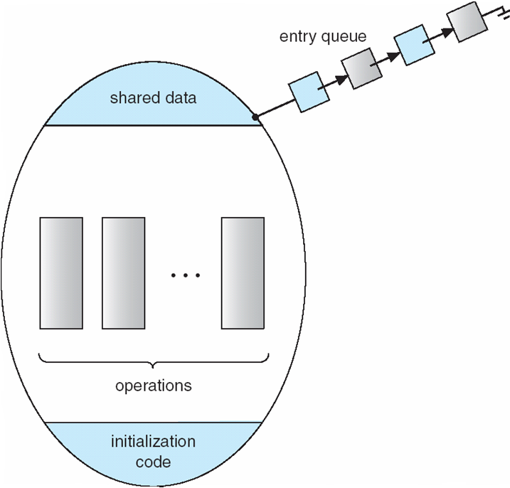
Schematic view of a Monitor

Slide 113
Condition Variables
condition x, y;
Two operations on a condition variable:
x.wait () – a process that invokes the operation is suspended.
x.signal () – resumes one of processes (if any) that
invoked x.wait ()

Slide 114
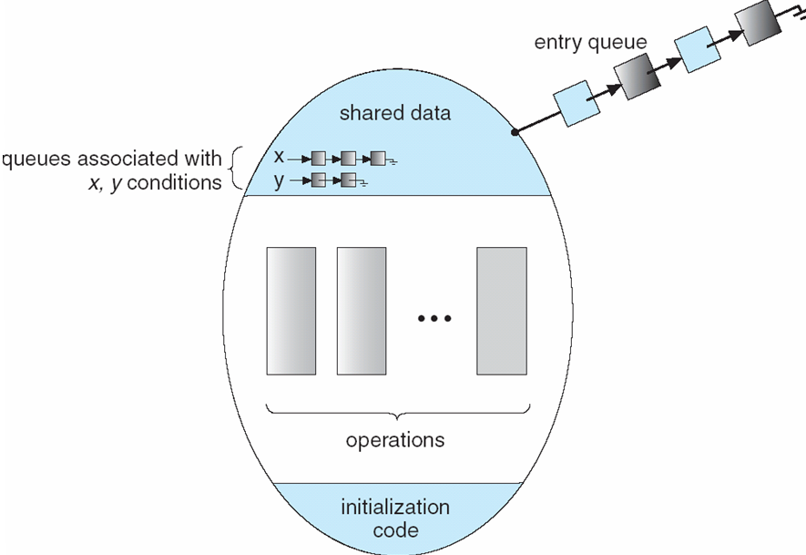
Monitor with Condition Variables

Slide 115
Condition Variables
Condition variables are not semaphores. They are different even though they look similar.
A condition variable does not count: have no associated integer.
A signal on a condition variable x is lost (not saved for future use) if there is no process waiting (blocked) on the condition variable x.
The wait() operation on a condition variable x will always cause the caller of wait to block.
The signal() operation on a condition variable will wake up a sleeping process on the condition variable, if any. It has no effect if there is nobody sleeping.

Slide 116
Condition variables: example
Lets us do an example.
Assume we have a resource to be accessed by many processes. Assume we have 5 instanced of the resource. 5 processes can use the resource simultaneously.
We want to implement a monitor that will implement two functions: acquire() and release() that can be called by a process before and after using a resource.

Slide 117
Condition variables: example
monitor Allocate {
int count = 5; // we initialize count to 5.
condition c;
void acquire () {
if (count == 0)
c.wait();
count--;
}
void release () {
count++;
c.signal();
}
}

Slide 118
Condition variables: example
A process will be coded like the following:
Allocate MA; // resource allocation monitor
….
MA.acquire();
// ….use the resource …
MA.release();
….

Slide 119
Monitor Solution to Dining Philosophers
monitor DP {
enum { THINKING; HUNGRY, EATING) state [5] ;
condition cond [5];
void pickup (int i) {
state[i] = HUNGRY;
test(i);
if (state[i] != EATING)
cond[i].wait;
}
void putdown (int i) {
state[i] = THINKING;
// test left and right neighbors
test((i + 4) % 5)
test((i + 1) % 5);
}
void test (int i) {
if ( (state[(i + 4) % 5] != EATING) &&
(state[(i + 1) % 5] != EATING) &&
(state[i] == HUNGRY)) {
state[i] = EATING ;
cond[i].signal ();
}
}
initialization_code() {
for (int i = 0; i < 5; i++)
state[i] = THINKING;
}
} /* end of monitor */

Slide 120
Solution to Dining Philosophers (cont)
Each philosopher invokes the operations pickup() and putdown() in the following sequence:
Philosopher i
…
DP DiningPhilosophers;
….
while (1)
THINK…
DiningPhilosophters.pickup (i);
EAT /* use resource(s) */
DiningPhilosophers.putdown (i);
THINK…
}

Slide 121
Monitor Solution to Dining Philosophers
#define LEFT (i+4)%5
THINKING?
HUNGRY?
EATING?
#define RIGHT (i+1)%5
state[LEFT] = ?
state[i] = ?
state[RIGHT] = ?
Process (i+4) % 5
Process i
Process (i+1) % 5
…
…
Test(i+4 %5)
Test(i)
Test(i+1 %5)

Slide 122
A Monitor to Allocate Single Resource
We would like to apply a priority based allocation. The process that will use the resource for the shortest amount of time will get the resource first if there are other processes that want the resource.
Processes or Threads that want to use the resource
….
Resource

Slide 123
A Monitor to Allocate Single Resource
Assume we have condition variable implementation that can enqueue sleeping processes with respect to a priority specified as a parameter to wait() call.
cond x;
…
x.wait (priority);
Queue of sleeping processes waiting on condition x
X
10
20
45
70
priority could be the time-duration to use the resource

Slide 124
A Monitor to Allocate Single Resource
monitor ResourceAllocator
{
boolean busy;
condition x;
void acquire(int time) {
if (busy)
x.wait(time);
busy = TRUE;
}
void release() {
busy = FALSE;
x.signal();
}
initialization_code() {
busy = FALSE;
}
}

Slide 125
A Monitor to Allocate Single Resource
Process 1
Process 2
Process N
ResourceAllocator RA;
RA.acquire(10);
…
….use resource…
….
RA.release();
ResourceAllocator RA;
RA.acquire(30);
…
….use resource…
….
RA.release();
ResourceAllocator RA;
RA.acquire(25);
…
….use resource…
….
RA.release();
…
Each process should use resource between acquire() and release() calls.

Slide 126
Spin Locks
Kernel uses to protect short critical regions (a few instructions) on multi-processor systems.
Assume we have a process A running in CPU 1 and holding a spin lock and executing the critical region touching to some shared data.
Assume at the same, another process B running in CPU 2 would like run a critical region touching to the same shared data.
B can wait on a semaphore, but this will cause B to sleep (a context switch is needed; costly operation). However, critical section of A is short; It would be better if B would busy wait for a while; then the lock would be available.
Spin Locks are doing this. B can use a Spin Lock to wait (busy wait) until A will leave the critical region and releases the Spin Lock. Since critical region is short, B will not wait much.

Slide 127
Spin Locks
Process A running in kernel mode (i.e. executing kernel code shown)
Process B running in kernel mode (i.e. executing kernel code shown)
f1() {…
acquire_spin_lock_(X);
…//critical region….
…touch to SD (shared data);
release_spin_lock(X);
}
f2() {…
acquire_spin_lock_(X);
…//critical region….
…touch to SD (shared data);
release_spin_lock(X); …
}
CPU 1
CPU 2
Kernel
X
lock variable (accessed atomically)
Main
Memory
f1() {…}
f2() {…}
SD
shared data

Slide 128
Spin Locks
a spin lock can be acquired after busy waiting.
Remember the TestAndSet or Swap hardware instructions that are atomic even on multi-processor systems. They can be used to implement the busy-wait acquisition code of spin locks.
While process A is in the critical region, executing on CPU 1 and having the lock (X set to 1), process A may be spinning on a while loop on CPU 2, waiting for the lock to be become available (i.e. waiting X to become 0). As soon as process A releases the lock (sets X to 0), process B can get the lock (test and set X), and enter the critical region.

Slide 129
Synchronization Examples
Solaris
Windows XP
Linux
Pthreads

Slide 130
Solaris Synchronization
Implements a variety of locks to support multitasking, multithreading (including real-time threads), and multiprocessing
Uses adaptive mutexes for efficiency when protecting data from short code segments
Uses condition variables and readers-writers locks when longer sections of code need access to data
Uses turnstiles to order the list of threads waiting to acquire either an adaptive mutex or reader-writer lock

Slide 131
Windows XP Synchronization
Uses interrupt masks to protect access to global resources on uniprocessor systems
Uses spinlocks on multiprocessor systems
Also provides dispatcher objects which may act as either mutexes and semaphores
Dispatcher objects may also provide events
An event acts much like a condition variable

Slide 132
Linux Synchronization
Linux:
Prior to kernel Version 2.6, disables interrupts to implement short critical sections
Version 2.6 and later, fully preemptive
Linux provides:
semaphores
spin locks

Slide 133
Pthreads Synchronization
Pthreads API is OS-independent
It provides:
mutex locks
condition variables
Non-portable extensions include:
read-write locks
spin locks

Slide 134
References
The slides here are adapted/modified from the textbook and its slides: Operating System Concepts, Silberschatz et al., 7th & 8th editions, Wiley.
Operating System Concepts, 7th and 8th editions, Silberschatz et al. Wiley.
Modern Operating Systems, Andrew S. Tanenbaum, 3rd edition, 2009.

Slide 135
Additional Study Material

Slide 136
Monitor Implementation Using Semaphores
Variables
semaphore mutex; // (initially = 1); allows only one process to be active
semaphore next; // (initially = 0); causes signaler to sleep
int next-count = 0; /* num sleepers since they signalled */
Each procedure F will be replaced by
wait(mutex);
…
body of F;
…
if (next_count > 0)
signal(next)
else
signal(mutex);
Mutual exclusion within a monitor is ensured.

Slide 137
Monitor Implementation Using Semaphores
Condition variables: how do we implement them?
Assume the following strategy is implemented regarding who will run after a signal() is issued on a condition variable:
“The process that calls signal() on a condition variable is blocked. It can not be waken up if there is somebody running inside the monitor”.
Some programming languages require the process calling signal to quit monitor by having the signal() call as the last statement of a monitor procedure.
Such a strategy can be implemented in a more easy way.

Slide 138
Monitor Implementation Using Semaphores
For each condition variable x, we have:
semaphore x_sem; // (initially = 0); causes caller of wait to sleep
int x-count = 0; // number of sleepers on condition
The operation x.wait can be implemented as:
x-count++;
if (next_count > 0)
signal(next);
else
signal(mutex);
wait(x_sem);
x-count--;
The operation x.signal can be implemented as:
if (x-count > 0) {
next_count++;
signal(x_sem);
wait(next); next_count--;
}

